Slide 1


Course in Obstetrics & Gynecology
Presented by Dr Rawan Yaseen
Specialist in Obstetrics and gynecology
Member of the Jordanian and the Arab board

Slide 2

Antepartum Fetal Assessment

Slide 3

GOAL
Identify fetuses at risk of intrauterine death or developing neurologic complications from slowly progressive (chronic) intrauterine hypoxia
Intervene to prevent these adverse outcomes, if possible.

Slide 4
POTENTIAL BENEFITS AND HARMS
Potential benefits:
the major benefit would be the ability to identify fetuses in whom appropriate timely intervention would prevent death or adverse neurologic outcomes.
Potential harms:
false-positive tests that lead the provider to unnecessary additional fetal evaluation and/or intervention
False-negative tests that do not alert the provider to the need for further fetal evaluation and/or intervention

Slide 5
INDICATIONS FOR FETAL ASSESSMENT
●Diabetes – Preexisting or gestational diabetes treated with pharmacotherapy
●Hypertensive disorders – Chronic hypertension or pregnancy-related hypertension
●Fetal growth restriction –
●Twin pregnancy –
●Postterm pregnancy – Testing is often initiated between 41+0 and 42+0 weeks of gestation
●Decreased fetal activity –
●Systemic lupus erythematosus –
●Antiphospholipid syndrome –
●Sickle cell disease –
●Alloimmunization to red blood cell antigens –
●Oligohydramnios or polyhydramnios –\
●Prior fetal demise –
●Preterm prelabor rupture of membranes –

Slide 6
Possible indications
Advanced maternal age.
Obesity
Major fetal structural anomalies
Abnormalities in first- and second-trimester maternal biochemical trisomy 21 (Down syndrome) screening results

Slide 7
FETAL ASSESSMENT TECHNIQUES
Fetal movement counting
fetal movement decreases in response to fetal hypoxemia
Cardiotocographic techniques
Nonstress test
Nonstress test with assessment of amniotic fluid
Sonographic techniques
Biophysical profile
Assessment of amniotic fluid volume
Objective maternal assessment
Contraction stress test
Doppler velocimetry

Slide 8
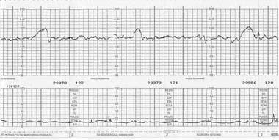
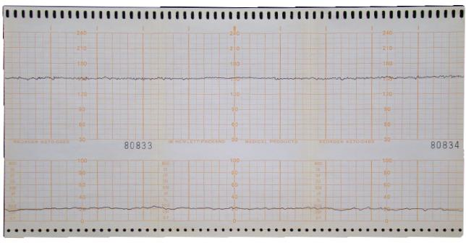
Nonstress test --- NST
Reactive tests
> 32 weeks -- two or more accelerations reaching a peak of at least 15 bpm above the baseline rate and lasting at least 15 sc in a 20-minute period
<32 weeks --- two or more accelerations that rise at least 10 bpm above baseline and have a duration of at least 10 sc in 20-minute period
Non-Reactive tests
not meet acceleration criteria for a reactive NST
should be monitored for at least 40 minutes
60 % false positives
Nonstress test with assessment of amniotic fluid — improve sensitivity

Slide 9
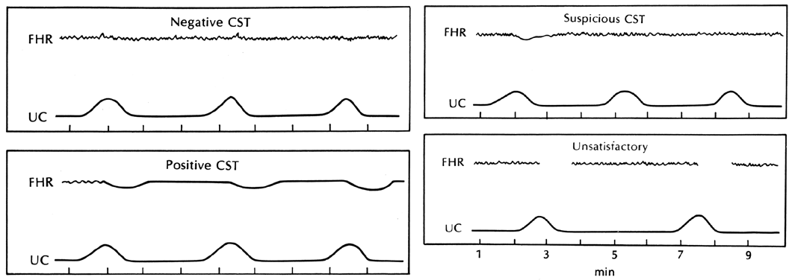
Contraction stress test
Dilute oxytocin solution is infused or nipple stimulation is performed until three contractions occur within 10 minutes
Limited by contraindications
Positive
abnormal test has --- late decelerations following ≥50 percent of contractions
Negative
normal test --- no late decelerations or significant variable decelerations
Equivocal
intermittent late decelerations or significant variable decelerations
Unsatisfactory
fewer than three contractions in 10 minutes

Slide 10
Sonographic techniques
Biophysical profile
Nonstress test: 2 points if reactive, defined as at least 2 episodes of FHR accelerations of at least 15 bpm and at least 15 seconds duration from onset to return associated with fetal movement.
Fetal breathing movements: 2 points if one or more episodes of rhythmic breathing movements of ≥30 seconds within a 30-minute observation period.
Fetal tone: 2 points if one or more episodes of extension of a fetal extremity or fetal spine with return to flexion.
Amniotic fluid volume: 2 points if a single deepest vertical pocket ≥2 cm is present. The horizontal dimension should be at least 1 cm.
Fetal movement: 2 points if three or more discrete body or limb movements within 30 minutes of observation. An episode of active continuous movement is counted as one movement.
Normal --- 10/10, 8/8 (nonstress test not done), or 8/10 (including +2 points for amniotic fluid)
Equivocal --- 6/10 (including +2 points for amniotic fluid)
Abnormal --- 6/10 or 8/10 with oligohydramnios (0 points for amniotic fluid)

Slide 11
The modified biophysical profile --- NST and assessment of AFV --- abnormal if the NST is nonreactive, no single deepest vertical pocket of amniotic fluid ≥2 cm is present, or both.

Slide 12
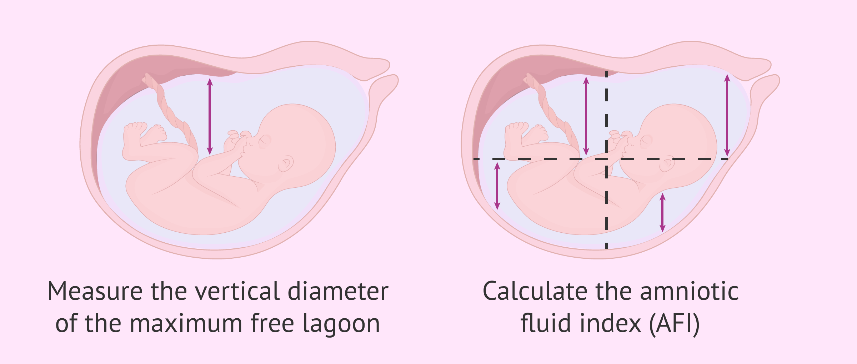
Assessment of amniotic fluid volume —
Amniotic fluid index — the sum of these measurements
Oligohydramnios – AFI ≤5 cm
Normal – AFI >5 cm and <24 cm
Polyhydramnios – AFI ≥24 cm
Single deepest pocket —
Oligohydramnios – Depth <2 cm
Normal – Depth ≥2 cm and <8 cm
Polyhydramnios – Depth ≥8 cm

Slide 13
Doppler velocimetry
Umbilical artery
Middle cerebral artery
Venous system ---- ductus venosus and inferior vena cava and the umbilical vein are the vessels most commonly evaluated
Uterine artery

Slide 14
CHOICE OF TEST
The choice depends on multiple factors
gestational age
Availability
desire for fetal biometry or follow-up of a congenital anomaly
ability to monitor the fetal heart rate (arrhythmia)
cost.

Slide 15
FOLLOW-UP
Normal
NPV for stillbirth within one week --99.8 -100 %
transient condition --- no follow up
chronic condition --- according to the cause
Abnormal
Transient condition --- repeat the test when the effects have dissipated --- if normal no follow up
Chronic condition ---
According to the Gestational age , Severity of maternal and fetal disease , Progression of disease --- delivery or follow up
Notes:
Testing is typically performed weekly in pregnancies at modestly increased risk of fetal demise because of an ongoing maternal or fetal disorder (see 'Indications for fetal assessment' above), but the frequency is often increased to two to seven times per week:
●If a change in pregnancy status occurs (eg, fetal growth percentile falls from 10th percentile to 3rd percentile, worsening preeclampsia).
●In clinical settings considered to be very high risk for fetal demise (eg, fetal growth restriction with absent or reversed diastolic flow, hydrops fetalis, patients with preeclampsia with severe features who are not being induced, preterm prelabor rupture of membranes).
●At 36 weeks of gestation. As the risk of stillbirth increases with advancing gestational age, testing may begin weekly at 32 weeks and then increased to twice per week at 36 weeks.
Fetuses with normal results are tested until the onset of labor. In the absence of spontaneous labor, the decision to continue antepartum testing versus induction of labor (or scheduled cesarean delivery) depends on the indication for testing. For example, patients with preeclampsia without features of severe disease are routinely delivered at 37 weeks of gestation (see "Preeclampsia: Management and prognosis", section on 'Timing of delivery'). Pregnant patients undergoing testing for conditions only modestly associated with an increased risk of stillbirth, such as advanced maternal age or obesity without comorbidities, might prefer induction at 39 weeks of gestation rather than expectant management plus fetal testing since the risk of stillbirth is lower with induction [11].
Chronic condition as cause of abnormal result — Given the high rate of false-positive tests (table 2) and the high negative predictive value of a normal test, an abnormal test result is generally followed by additional testing with a different test (eg, contraction stress test [CST] or biophysical profile [BPP] after a nonreactive nonstress test [NST]) to provide more information about fetal status. However, clinical judgment should guide decision making regarding delivery versus follow-up testing after an abnormal test result, taking into account a combination of factors, as described below.
●Gestational age (eg, lower threshold for delivery at term versus preterm).
●Severity of maternal and fetal disease (eg, low threshold for delivery for hydrops fetalis, for diabetes with poor glycemic management versus good glycemic management, or for fetal growth restriction at 3rd percentile with oligohydramnios and abnormal umbilical artery Doppler flow versus 10th percentile with normal amniotic fluid volume and normal umbilical artery Doppler flow).
●Progression of disease (eg, low threshold for delivery when fetal growth falls from the 10th percentile to the 3rd percentile versus stable or slow but progressive growth).
●Other available information (eg, low threshold for delivery when late or variable decelerations, absent variability, or a prolonged deceleration on a nonreactive NST; BPP score 0 versus 4 or 6; absence of accelerations on a positive CST; intrauterine growth restriction with absent or reversed Doppler flow in umbilical artery).

Slide 16
Thank You

