Slide 1


Course in Obstetrics & Gynecology
Presented by Dr Rawan Yaseen
Specialist in Obstetrics and gynecology
Member of the Jordanian and the Arab board

Slide 2
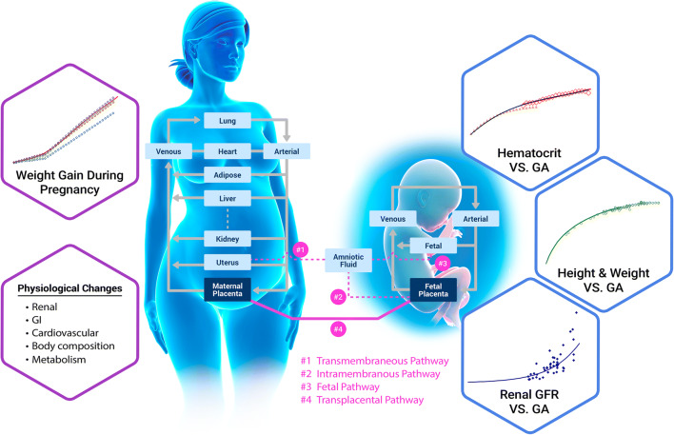
Maternal physiology during pregnancy

Slide 3
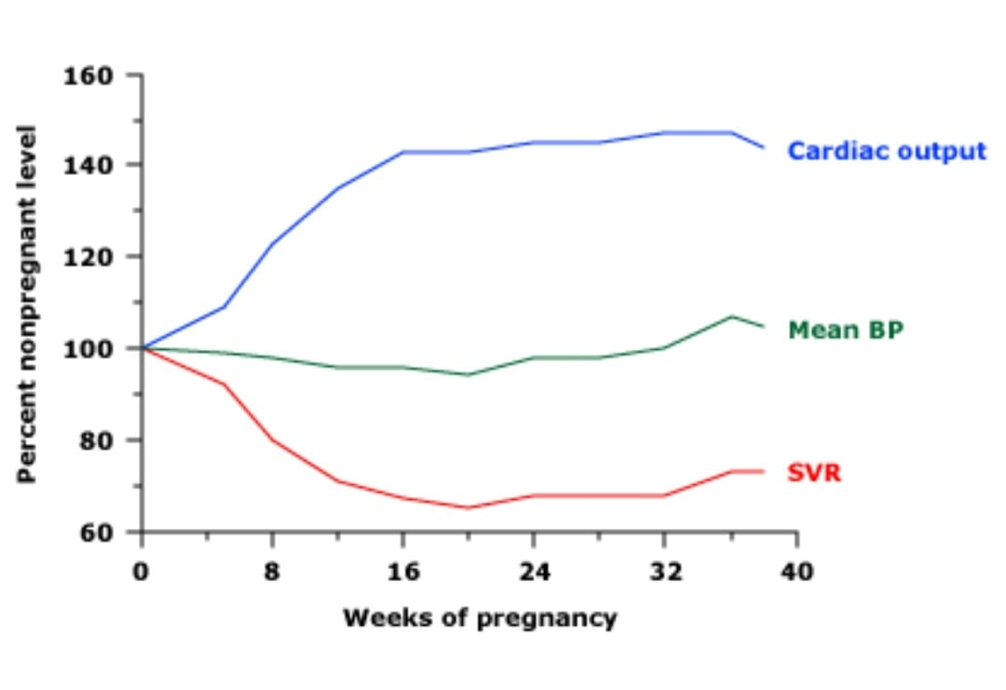
Cardiovascular and hemodynamic changes
Optimal growth and development of the fetus
Help to protect the mother from the risks of delivery, such as hemorrhage
Start at 5th week
Peak during 2nd and early 3rd trimester
Plateau until delivery

Slide 4
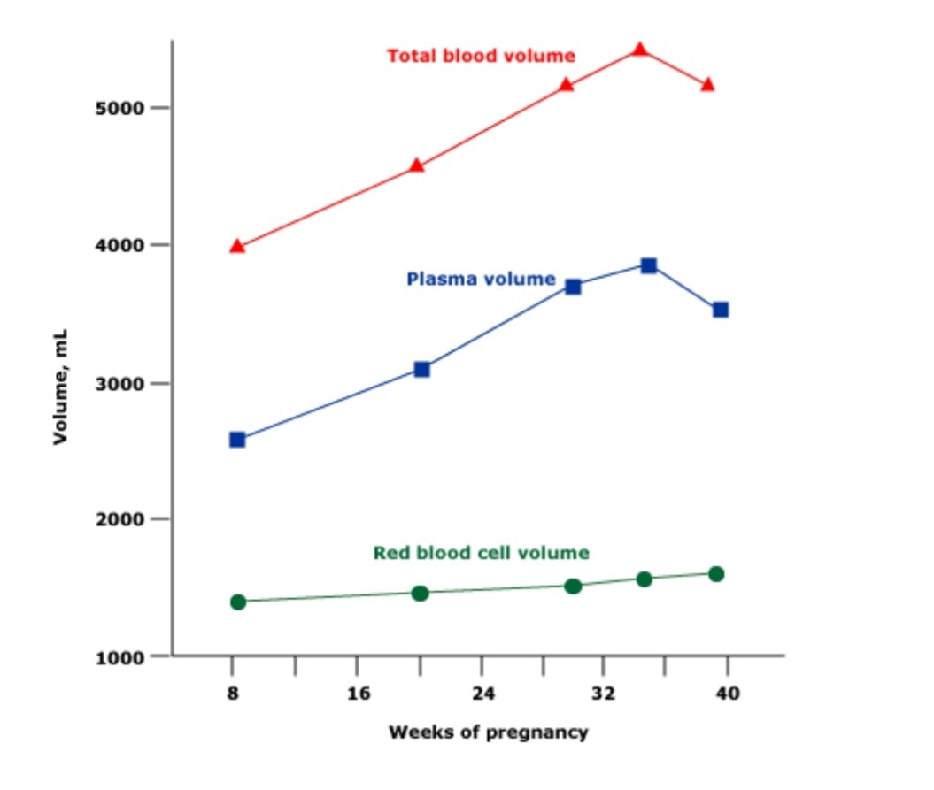
blood Volume
peak at 28 to 34 weeks
Plasma volume ---- increases by 30 -50 % ---- 1100 to 1600 mL
Red blood cell mass — increases by 20- 30 %
Blood volume :
Nonpregnant ---- 65 to 70 mL/kg
pregnant ----- 100 mL/kg
Physiological anemia
Decrease the viscosity
Increase the intravascular volume
Increase the perfusion to the placenta
1st trimester <11gm/dl
2nd,3rd trimester <10.5 g/dl

Slide 5
Blood pressure and vascular resistance
Systolic and diastolic BP fall early in gestation
The fall in BP is induced by a reduction in systemic vascular resistance (SVR)
Heart rate — increase 10 - 30 bpm
Cardiac function –contractility of the myocardium is stable to slightly improved

Slide 6
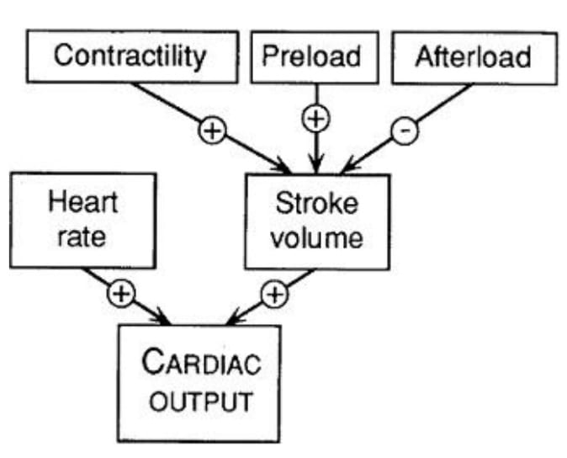
Cardiac output ---
increase 30 -50 %

Slide 7
uterine artery blood flow
In early pregnancy--- 3 -6 % --- 50-60 mL/minute
at term --- 12 % ---- 450-750 mL/minute

Slide 8
EVALUATION OF THE CARDIOVASCULAR SYSTEM IN PREGNANCY
Breathlessness, easy fatiguing, decreased exercise tolerance, and peripheral edema
heart is shifted to the left, anterior, and rotated toward a transverse position --- apical impulse is shifted to the fourth intercostal space and laterally to the midclavicular line.
Auscultatory changes --- A higher basal heart rate, louder heart sounds, wide splitting of S1, splitting of S2 in the third trimester, and a systolic ejection murmur (up to grade 2/6) , A third heart sound is present in most pregnant women
Diastolic murmurs --- pathologic condition necessitating further study

Slide 9
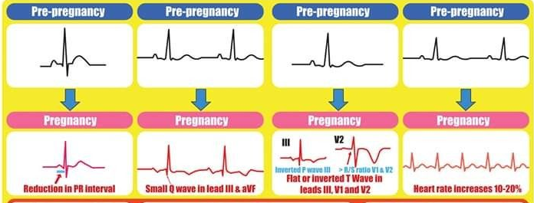
Electrocardiogram
15-20 degree left axis deviation
supraventricular tachycardia and ventricular extrasystoles
the presence of a Q wave -- lead III , lead AVF
inverted T waves in lead III, V1, V2 and, occasionally, V3

Slide 10
Echocardiogram
Physiologic multivalvular regurgitation
chamber enlargement, valvular annular dilatation, and a small asymptomatic pericardial effusion

Slide 11
Hematologic changes
White blood cells --- increase in the second month of pregnancy and plateaus in the second or third trimester, at which time WBC counts range from 9000 to 15,000 cells/microL
Platelet count ----- declines as pregnancy progresses, but generally remains in the normal nonpregnant range (150,000 -450,000/microL)
Physiological thrombocytopenia
In the vast majority of uncomplicated pregnancies, the platelet count remains ≥100,000/microL and returns to the prepregnancy baseline level by several weeks postpartum.

Slide 12
Coagulation and fibrinolysis
Normal pregnancy is a prothrombotic state
Increased procoagulant factors
Fibrinogen ----- factors II, VII, VIII, X, and XII ----von Willebrand factor (VWF)
Reduced anticoagulant factors
protein S decreases
unchanged
Antithrombin ---- Protein c ----Factor V , IX

Slide 13
physiological respiratory changes
mucosa --- hyperemia, glandular hyperactivity, increased phagocytic activity
nasal stuffiness and epistaxis

Slide 14
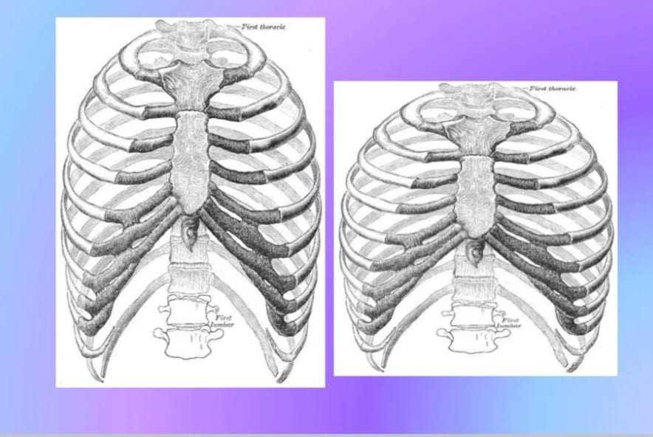
Chest wall configuration
Outward flaring of the ribs -- raise the diaphragm up to 4 cm above its usual resting position cm.

Slide 15
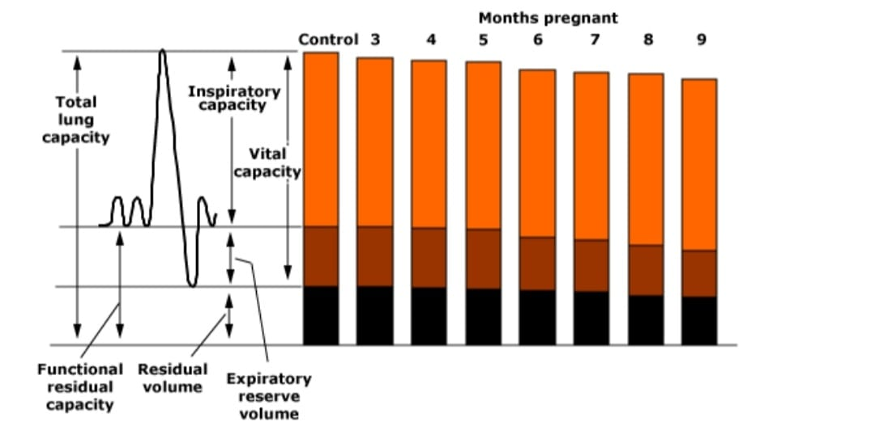
Lung volumes and flow rates
FRC decreases by approximately 20 %
VC and total lung capacity --- Variable and generally minor
unchanged FEV1 and FEV1/FVC ratio --- Airway function and flow rates are preserved

Slide 16
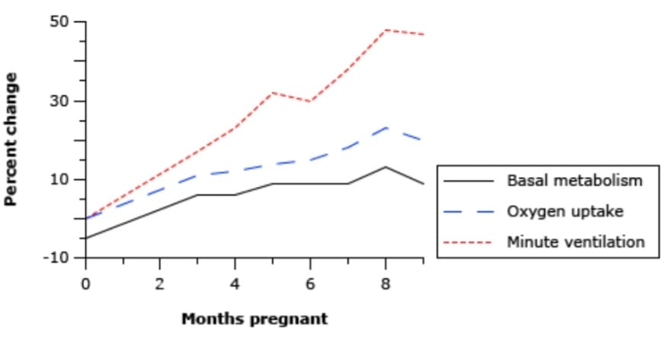
Ventilation
Resting minute ventilation -- rises 50 % at term
tidal volume --- increased up to 40 %
respiratory rate remains essentially unchanged
oxygen consumption increased 20 %

Slide 17
Gas exchange and arterial blood gases
arterial PCO2 falls to a plateau
arterial oxygen tension (PaO2) is generally increased
respiratory alkalosis is followed by compensatory renal excretion of bicarbonate so that the resultant arterial pH is normal to slightly alkalotic (usually between 7.40 and 7.45)

Slide 18
Gastrointestinal tract
Taste —taste perception changes during pregnancy
Gingiva — Enlargement and blunting of the interdental papillae of the gingiva may result in gingivitis
tooth mobility or erosion, oral gingival lesions, and dental caries

Slide 19
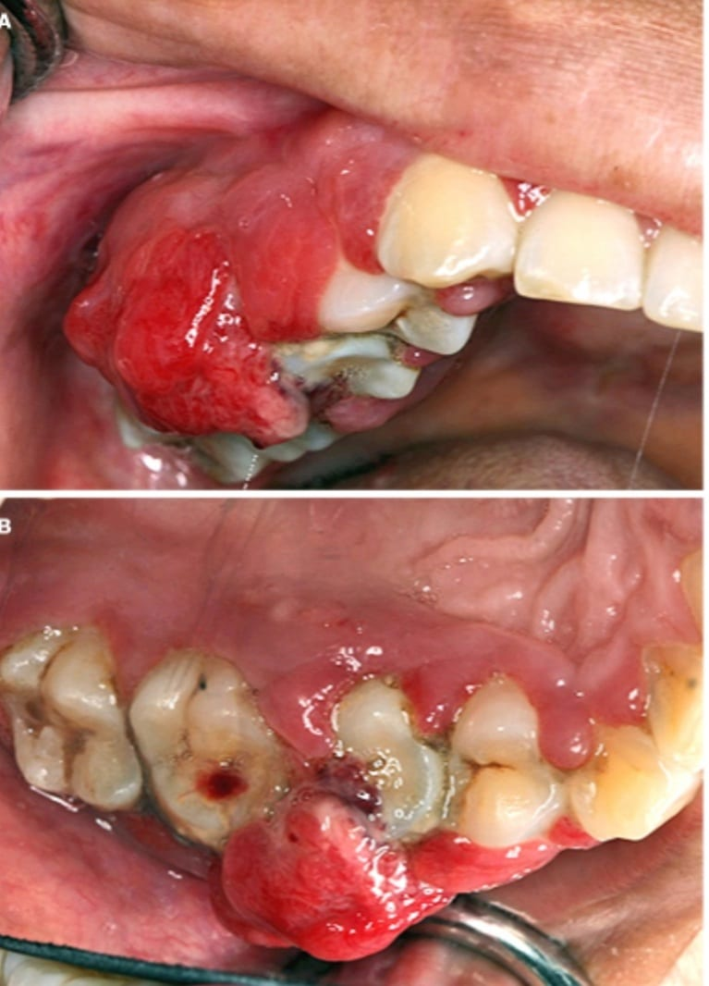
Pyogenic granuloma of pregnancy ( epulis ) —benign, vascular tumors with friable -- oral mucosa, lip, and tongue
Ptyalism gravidarum — excessive salivation -- 1.5 L to 2 L per day

Slide 20
Gastroesophageal reflux —40 -85 % of women during pregnancy
Aspiration of gastric contents —increased intra-abdominal pressure and relaxation of the lower esophageal sphincter
Nausea and vomiting —50-80 %

Slide 21
LIVER
Serum albumin --- decrease
Serum total cholesterol and triglyceride ---increase
Serum alkaline phosphatase --- significantly higher (up to two to four times normal)

Slide 22
GALLBLADDER
gallbladder motility --- decreases
the lithogenicity of bile--- increases
increased risk for gallstones
PANCREAS
Amylase levels --- normal
Acute pancreatitis --- rare --- associated with gallstones

Slide 23
Renal and urinary tract physiology
Both kidneys increase 1 to 1.5 cm in length during pregnancy
Kidney volume increases by up to 30 % -- due to an increase in renal vascular and interstitial volume
The renal pelvises and caliceal systems may be dilated as a result of progesterone effects and mechanical compression of the ureters at the pelvic brim --- hydronephrosis mostly at the right side

Slide 24
Hemodynamic changes —increased renal perfusion and GFR
Renal plasma flow increases by up to 80 %
GFR --- increases 40 -50 %
serum creatinine – decrease
a serum creatinine of 0.75 mg/dL (70.7 micromol/L) or above, while normal in a nonpregnant individual, usually reflects renal impairment in a pregnant patient

Slide 25
Proteinuria — Urinary protein excretion rises in normal pregnancy---greater than 300 mg/day is considered abnormal
Glucosuria — Glucosuria by dipstick ---50 % of pregnant patients--- primarily due to decreased proximal tubular glucose reabsorption

Slide 26
Bladder — The bladder mucosa is edematous and hyperemic in pregnancy.
Vesicoureteral reflux — Bladder flaccidity may cause incompetence of the vesicoureteral valve.

Slide 27
Skin and related structures
Changes in pigmentation – Almost all pregnant women develop some degree of increased skin pigmentation
Melasma (ie, chloasma or mask of pregnancy) is the most cosmetically disturbing pigmentary change and occurs in up to 75 %

Slide 28
Vascular changes – Estrogen and other factors cause vascular distention, vascular instability, and proliferation of blood vessels during pregnancy.
vascular spiders , palmar erythema, varicosities (eg, lower limb, anorectum, vulva), and vascular tumors

Slide 29
Striae gravidarum – Striae gravidarum (stretch marks) are due to connective tissue changes and are most prominent on the abdomen, breasts, and thighs, but also arise on the lower back, buttocks, and upper arms.
Hair – Hirsutism increases during pregnancy. Scalp hair becomes thicker, but the hair line may recede. Postpartum, a temporary period of hair loss is common (ie, telogen effluvium).

Slide 30
Thank You

